Slide 1

COMPUTER NETWORKS (BCSC 0008)
Copyright content, use only with the written permission of presenter mentioned
Lecture: TCP/IP Protocol suit

Slide 2
TCP/IP Protocol Suite
The TCP/IP protocol suite is made of five layers: physical, data link, network, transport, and application. The first four layers provide physical standards, network interface, internetworking, and transport functions that correspond to the first four layers of the OSI model. The three topmost layers in the OSI model, however, are represented in TCP/IP by a single layer called the application layer.
The topics discussed in this section include:
Physical and Data Link Layers
Network Layer
Transport Layer
Application Layer

Slide 3
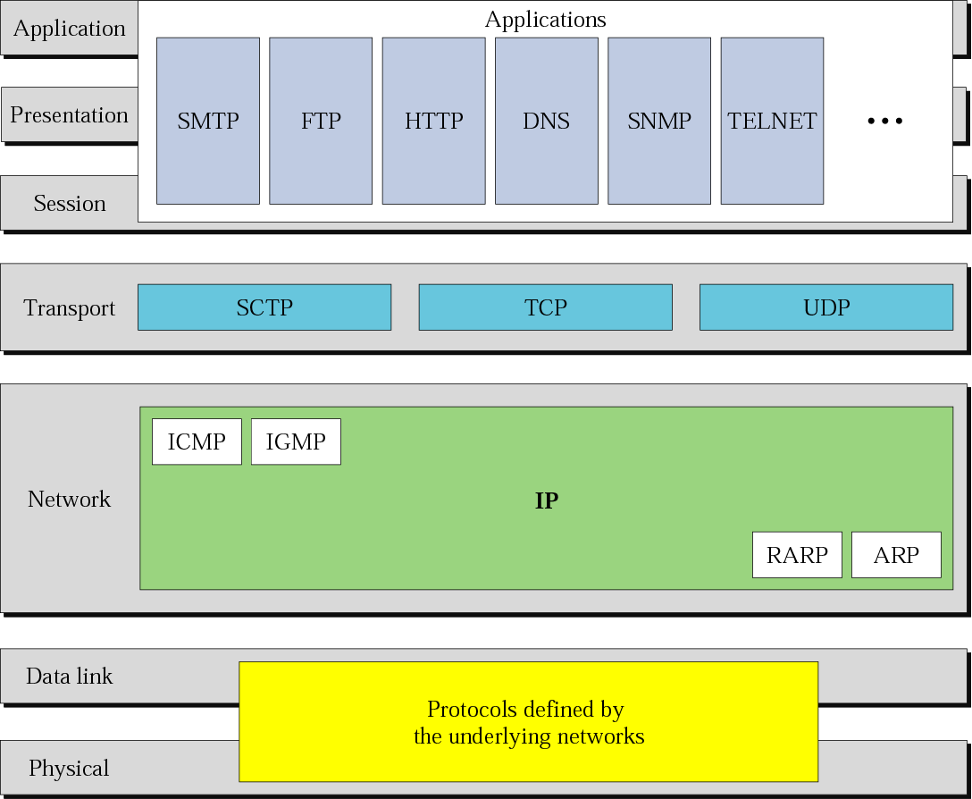
TCP/IP Protocol Suit

Slide 4
Addressing
Three different levels of addresses are used in an internet using the TCP/IP protocols: physical (link) address, logical (IP) address, and port address.
The topics discussed in this section include:
Physical Address
Logical Address
Port Address

Slide 5
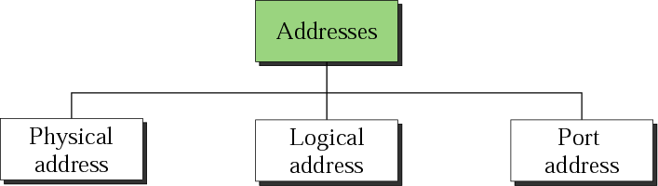
Figure 2.16 Addresses in TCP/IP

Slide 6
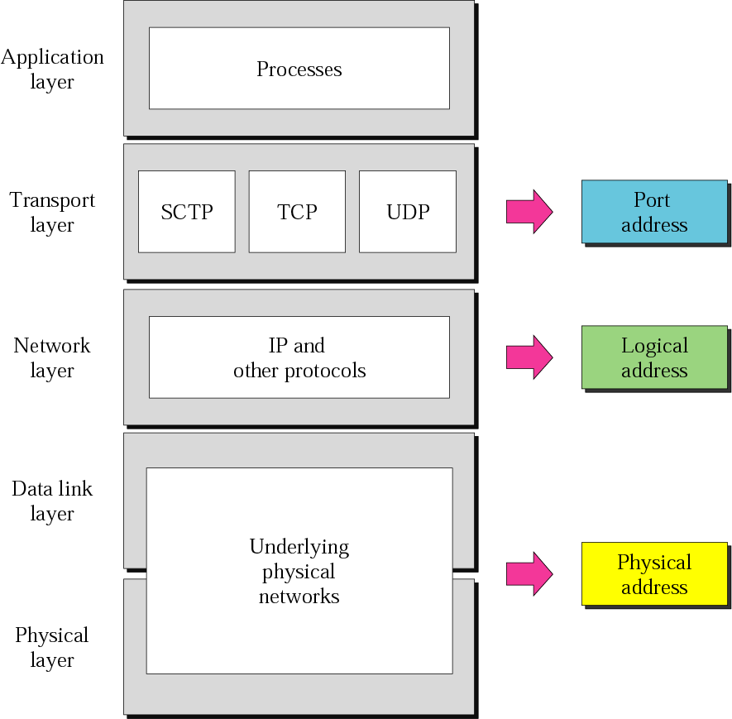
Figure 2.17 Relationship of layers and addresses in TCP/IP

Slide 7
Example 1
In Figure 2.18 a node with physical address 10 sends a frame to a node with physical address 87. The two nodes are connected by a link. At the data link level this frame contains physical (link) addresses in the header. These are the only addresses needed. The rest of the header contains other information needed at this level. The trailer usually contains extra bits needed for error detection.
See Next Slide

Slide 8
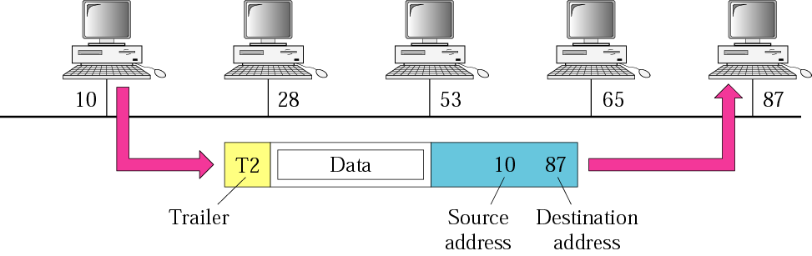
Figure 2.18 Physical addresses

Slide 9
Example 2
Most local area networks use a 48-bit (6 bytes) physical address written as 12 hexadecimal digits, with every 2 bytes separated by a colon as shown below:
07:01:02:01:2C:4B
A 6-byte (12 hexadecimal digits) physical address.

Slide 10
Example 3
We want to send data from a node with network address A and physical address 10, located on one LAN, to a node with a network address P and physical address 95, located on another LAN. Because the two devices are located on different networks, we cannot use link addresses only; the link addresses have only local jurisdiction. What we need here are universal addresses that can pass through the LAN boundaries. The network (logical) addresses have this characteristic.
See Next Slide

Slide 11
Example 3 (Continued)
The packet at the network layer contains the logical addresses, which remain the same from the original source to the final destination (A and P, respectively, in the figure). They will not change when we go from network to network. However, the physical addresses will change as the packet moves from one network to another. The boxes labeled routers are internetworking devices.
See Next Slide

Slide 12
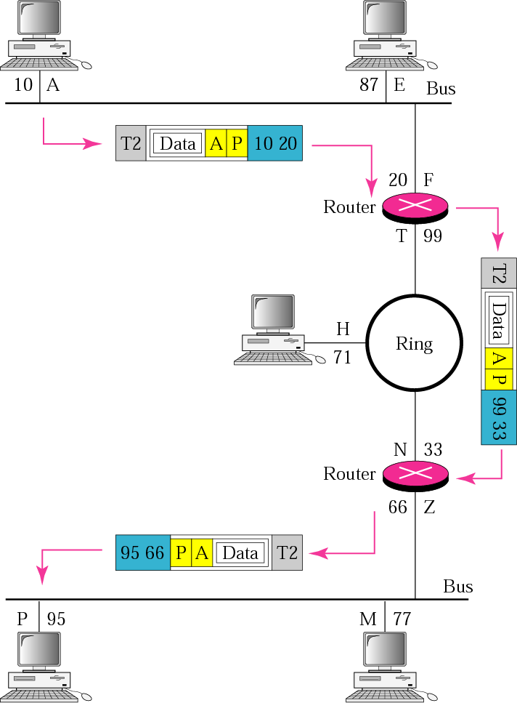
Figure 2.19 IP addresses

Slide 13
Example 4
An Internet address (in IPv4) is 32 bits in length, normally written as four decimal numbers, with each number representing 1 byte. The numbers are separated by a dot. Below is an example of such an address.
132.24.75.9 An internet address in IPv4 in decimal numbers

Slide 14
Example 5
An example of transport layer communication. Data coming from the upperlayers have port addresses j and k ( j is the address of the sending process, and k is the address of the receiving process). Since the data size is larger than the network layer can handle, the data are split into two packets, each packet retaining the service-point addresses ( j and k). Then in the network layer, network addresses (A and P) are added to each packet.
See Next Slide

Slide 15
Example 5 (Continued)
The packets can travel on different paths and arrive at the destination either in order or out of order. The two packets are delivered to the destination transport layer, which is responsible for removing the network layer headers and combining the two pieces of data for delivery to the upper layers.
See Next Slide

Slide 16
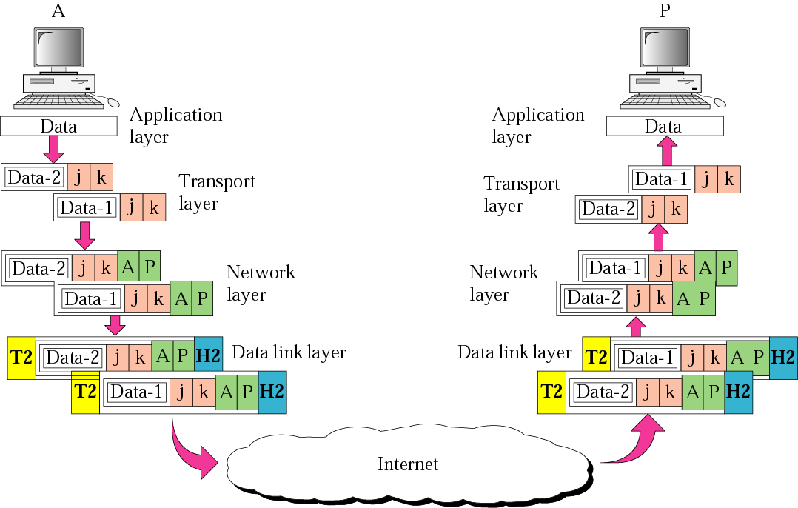
Figure 2.20 Port addresses

Slide 17
Example 6
As we will see in Chapters 11, 12, and 13, a port address is a 16-bit address represented by one decimal number as shown below.
753 A 16-bit port address represented as one single number.

